Slide 1
Lecture 17
Hamiltonian Cycles

Slide 2
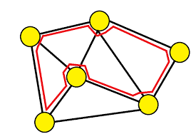
Introduction
Invented by William Rowan Hamilton in 1859.
Hamiltonian Path in an undirected graph is a path that visits each vertex exactly once.
A Hamiltonian cycle is a Hamiltonian Path such that there is an edge (in the graph) from the last vertex to the first vertex of the Hamiltonian Path.
Hamiltonian Graph is a graph that contains Hamiltonian cycle.
A Hamiltonian cycle can be converted into Hamiltonian path by removing one of its edges

Slide 3

Hamiltonian cycle Problem
Hamiltonian cycle Problem is a problem which determines whether the Hamiltonian path/cycle exists or not.
Both are NP-complete problems.
The problem of finding a Hamiltonian cycle or path in a graph is a special case of the traveling salesman problem, one where each pair of vertices with an edge between them is considered to have distance 1, while non-edge vertex pairs are separated by distance infinity.
In computational complexity theory, a problem is NP-complete when it can be solved by a restricted class of brute force search algorithms and it can be used to simulate any other problem with a similar algorithm.

Slide 4
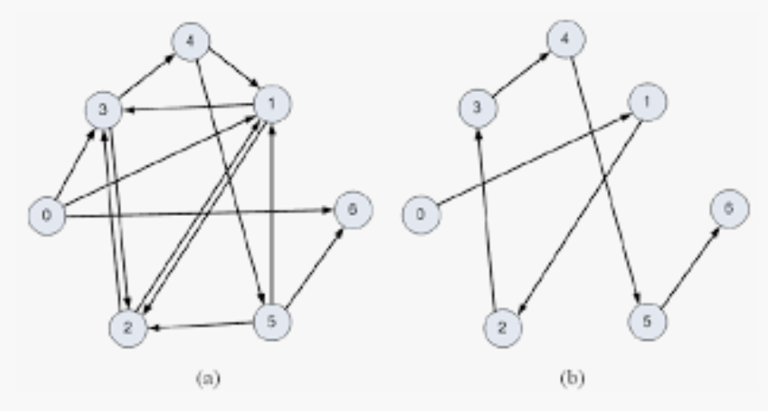
Hamiltonian cycle Problem
Input:
A graph G = (V,E).
Problem description:
Find an ordering of the vertices such that each vertex is visited exactly once.
Condition:
The cycle starts with the starting node and visits all the nodes in the graph not necessarily in the sequential order and not adding any edge not present in the graph,

Slide 5
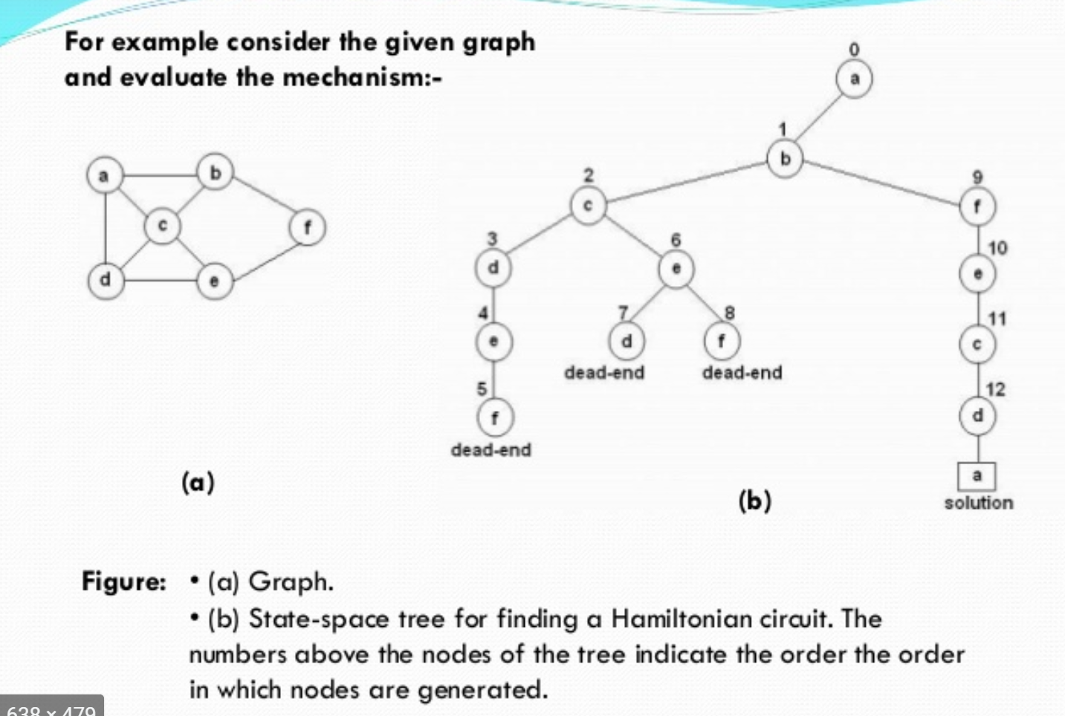

Slide 6
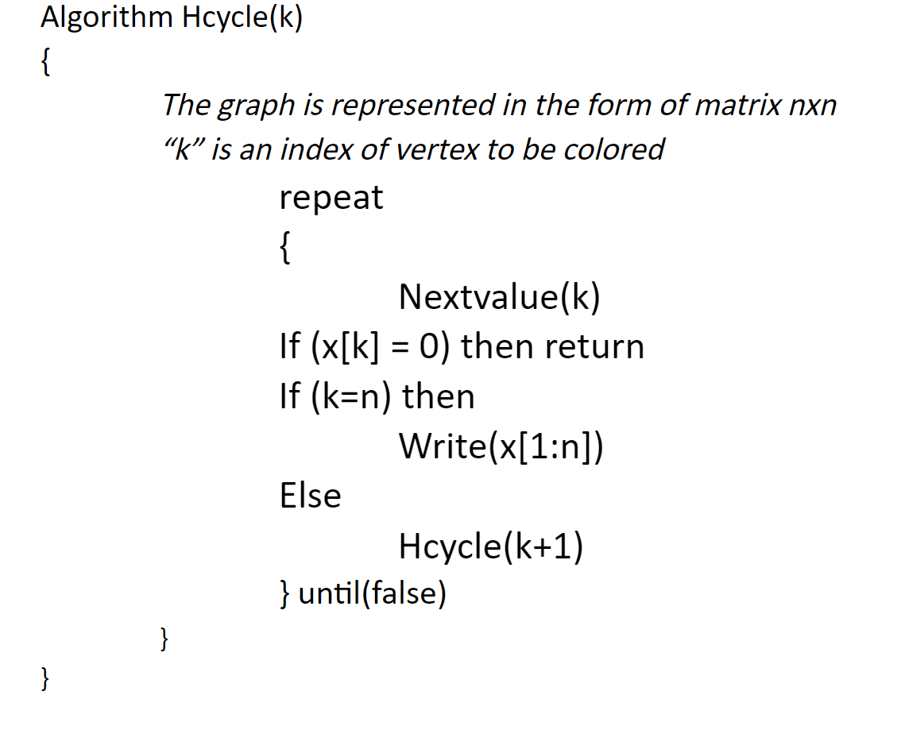
Algorithm: Hamiltonian Cycle

Slide 7
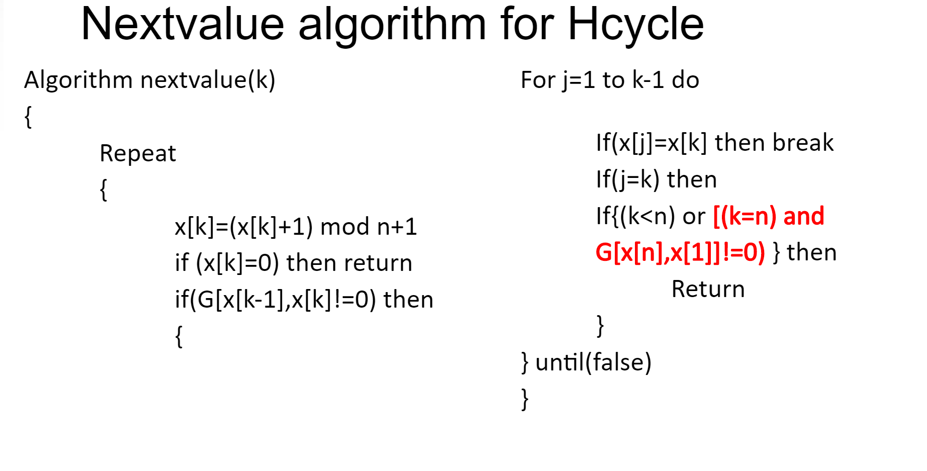
Nextvalue: Algorithm

Slide 8
Complexity Analysis
Time complexity of the above algorithm is O(2^{n}n²).

